Slide 1

Ideation bootcamp visualisatie
Notes:
Intro: Chakir

Slide 2
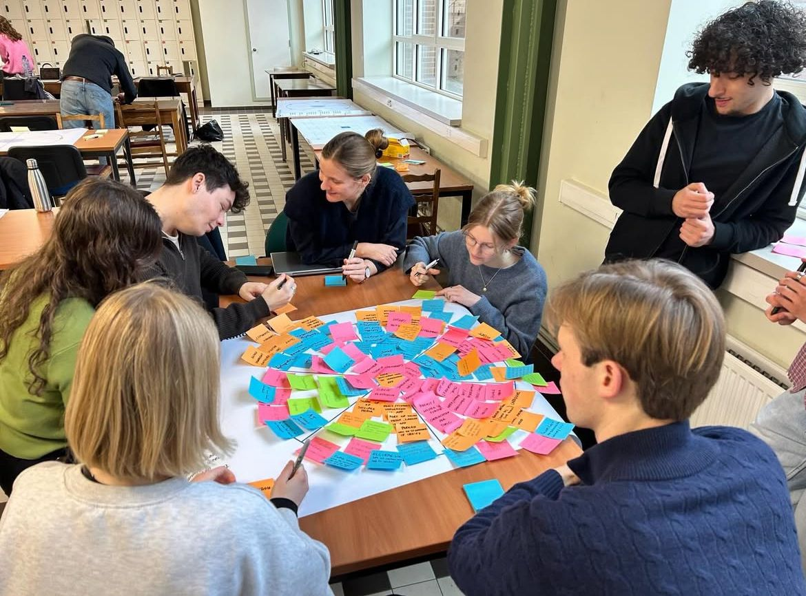
1. GPS brainstorm

Slide 3
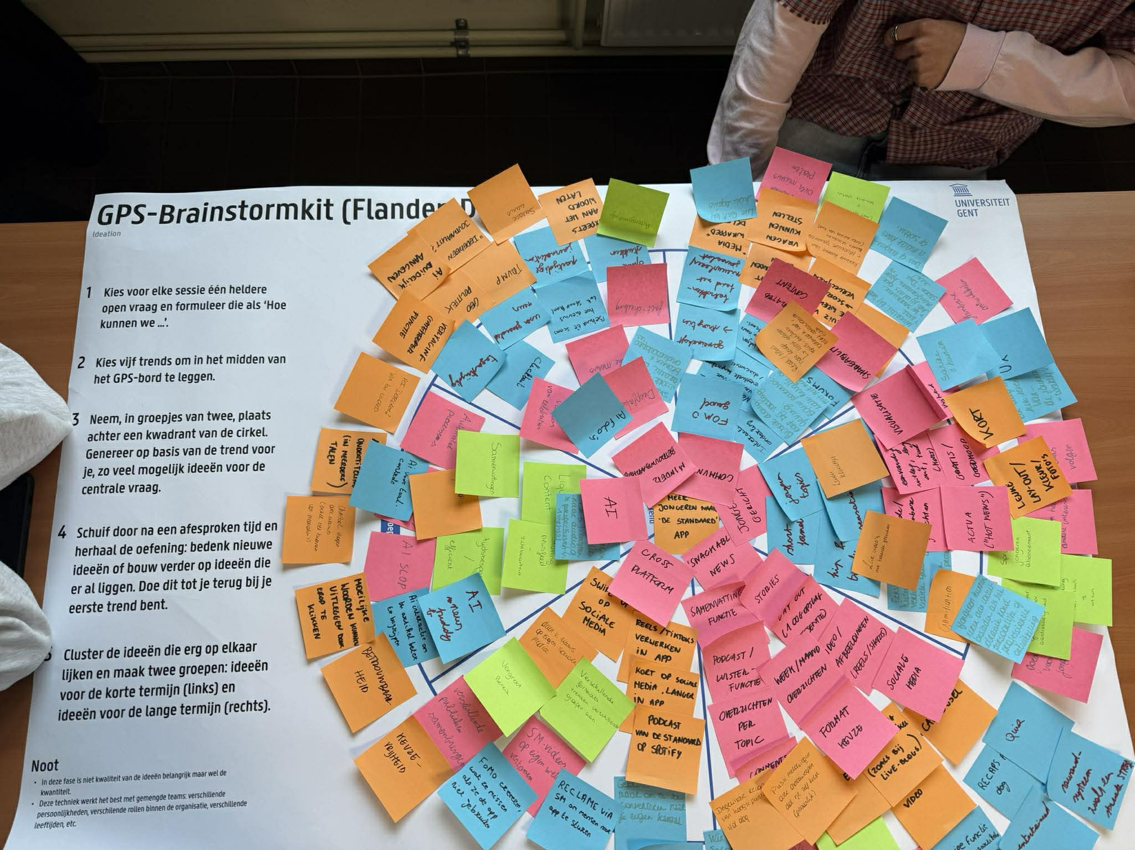

Slide 4
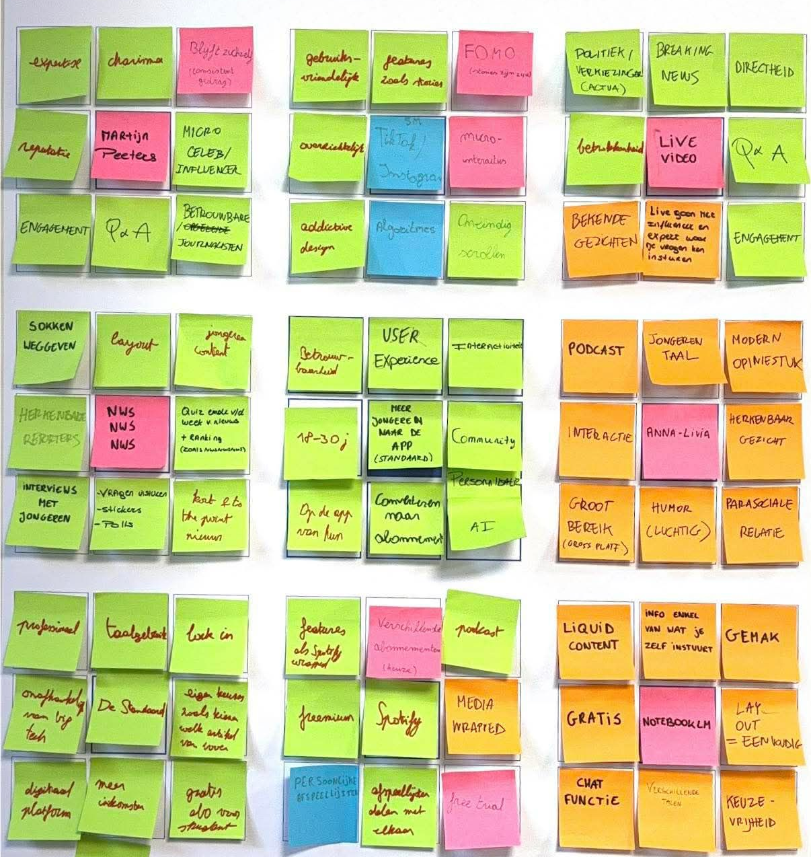
2. Lotus Blossom

Slide 5
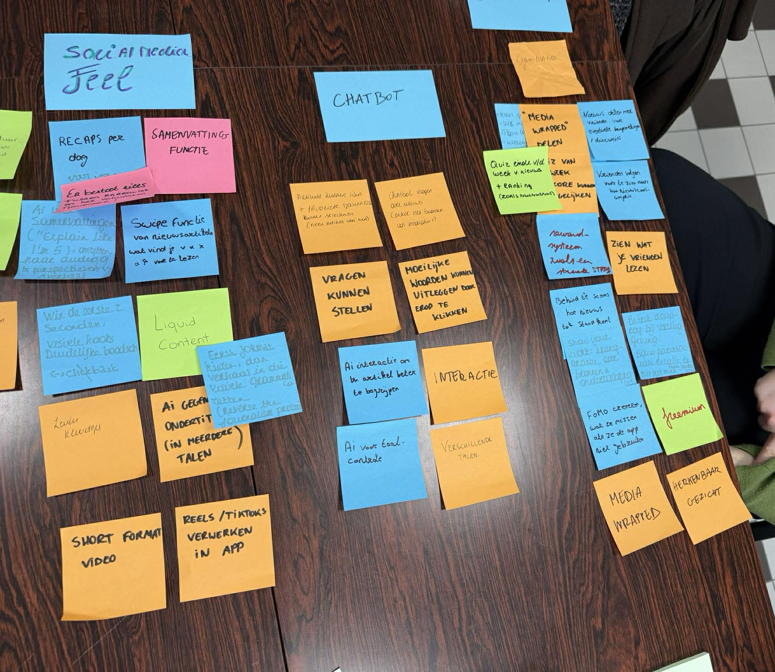
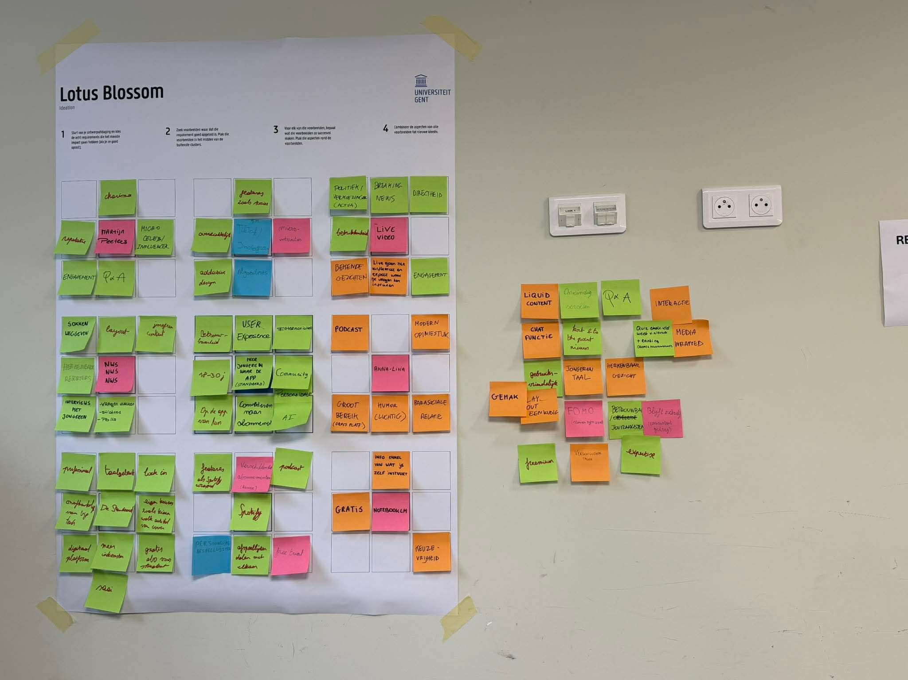
3. Clustering post-its GPS & Lotus Blossom

